Slide 1
Automatic fight detection in Surveillance videos
Presented by :
Abdulrahman El-feki
Shady Abdelaziz

Slide 2
PROBLEM STATEMENT
CCTV Surveillance is used to a greater extent but still it lacks the feature of automatic violence detection
Manual monitoring is not a feasible task and the time taken to respond to the situation is also crucial
Automatic fight detection system is proposed.

Slide 3
Project overview
Preprocessing
Model training
Model testing
Predict with videos
Predict with webcam

Slide 4
METHODOLOGY
Testing Video
Training Dataset
Data
MobileNet v2
Model
Testing Dataset
Image frames

Slide 5
METHODOLOGY
A dataset having A total of 3500 videos , 1750 videos each of violence category and non-violence category was chosen
A model was trained using MobileNetV2 using the dataset
videos is given as input
we use the model on the videos to predict (Fight - Non fight) as output

Slide 6
MOBILENET V2
Convolutional neural network that is 53 layers deep
Provides real-time classification capabilities under computing constraints in devices .
Utilizes an inverted residual structure where the input and output of the residual blocks are thin bottleneck layers.
Uses lightweight convolutions to filter features in the expansion layer

Slide 7
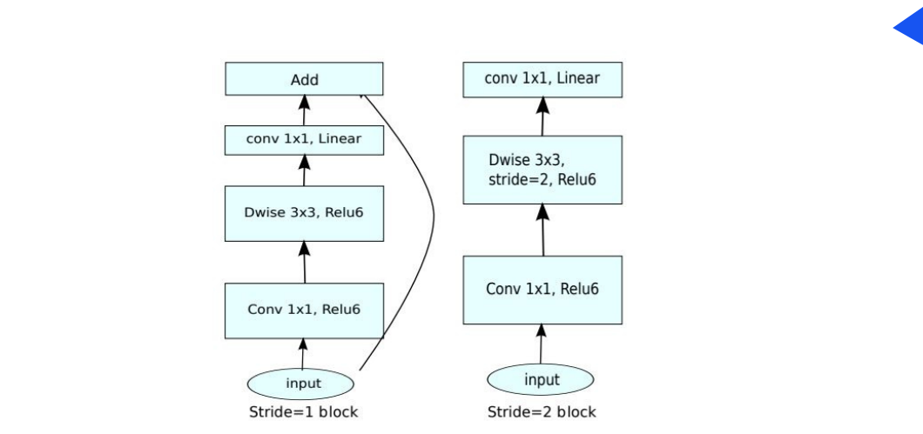
MOBILENET V2 ARCHITECTURE

Slide 8
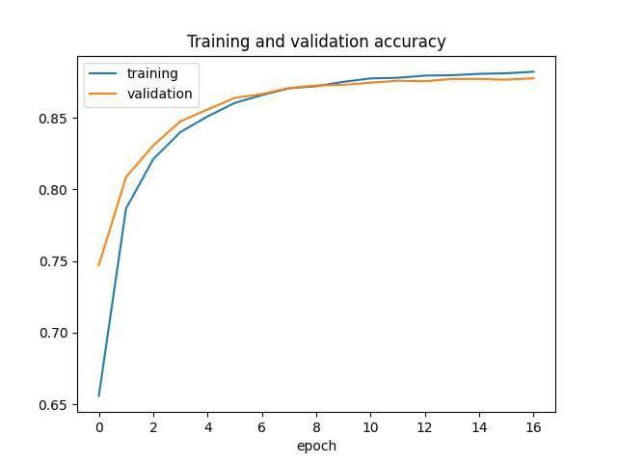
RESULTS

Slide 9
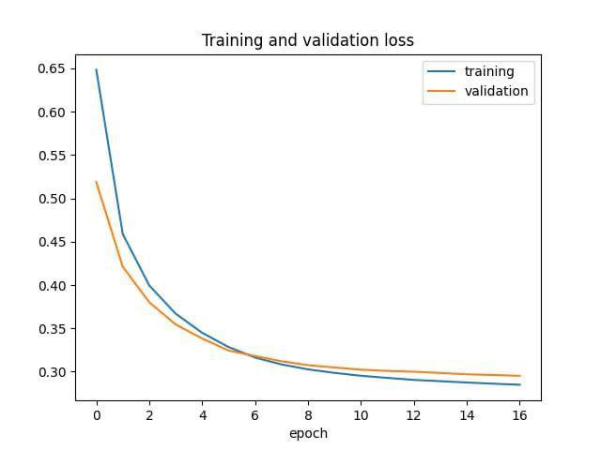
RESULTS

Slide 10
THANK YOU

